Slide 1
The effects of neuromuscular activity and muscle structure on stepping performance in older adults
Dr. Marcel B. Lanza
Assistant Professor
University of Maryland, Baltimore
Departament of Physical Therapy and Rehabilitation Sicence
mlanza@som.umaryland.edu

Slide 2
Outline
Who am I and what I do?
Pepper Pilot
Award
Introduction
Background
Research question
Study design / Data
What I want to see from this data

Slide 3
Who am I and what I do?

Slide 4
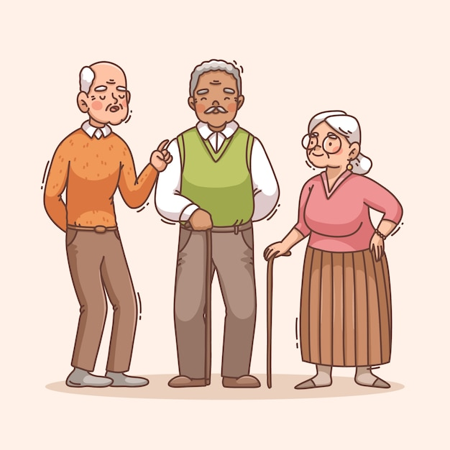
Assistant Professor
University of Maryland Baltimore
Aging research / Teaching
Understand the physiological and biomechanical mechanisms related to physical function

Slide 5
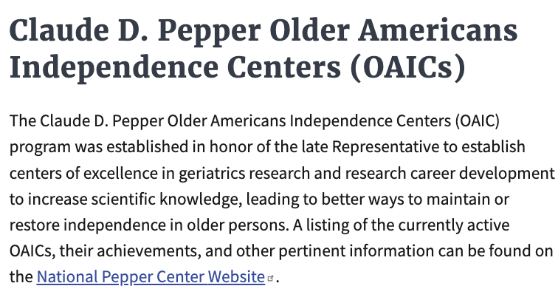



Pepper Pilot

Slide 6
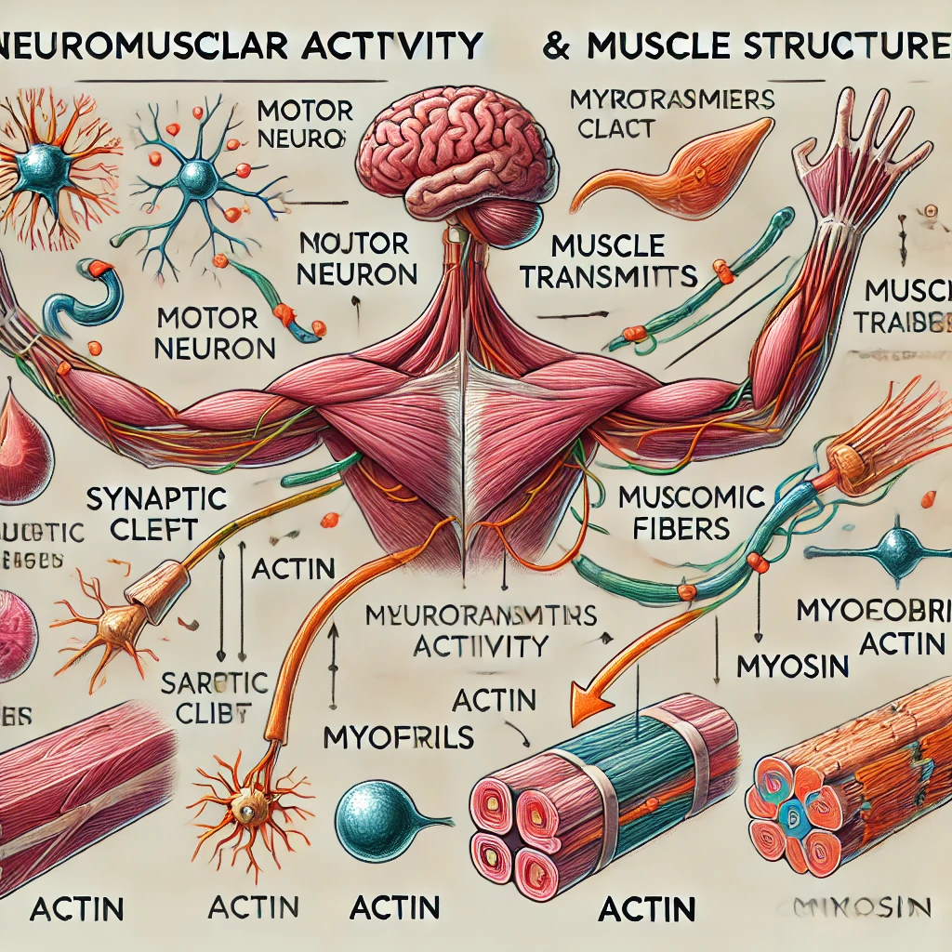
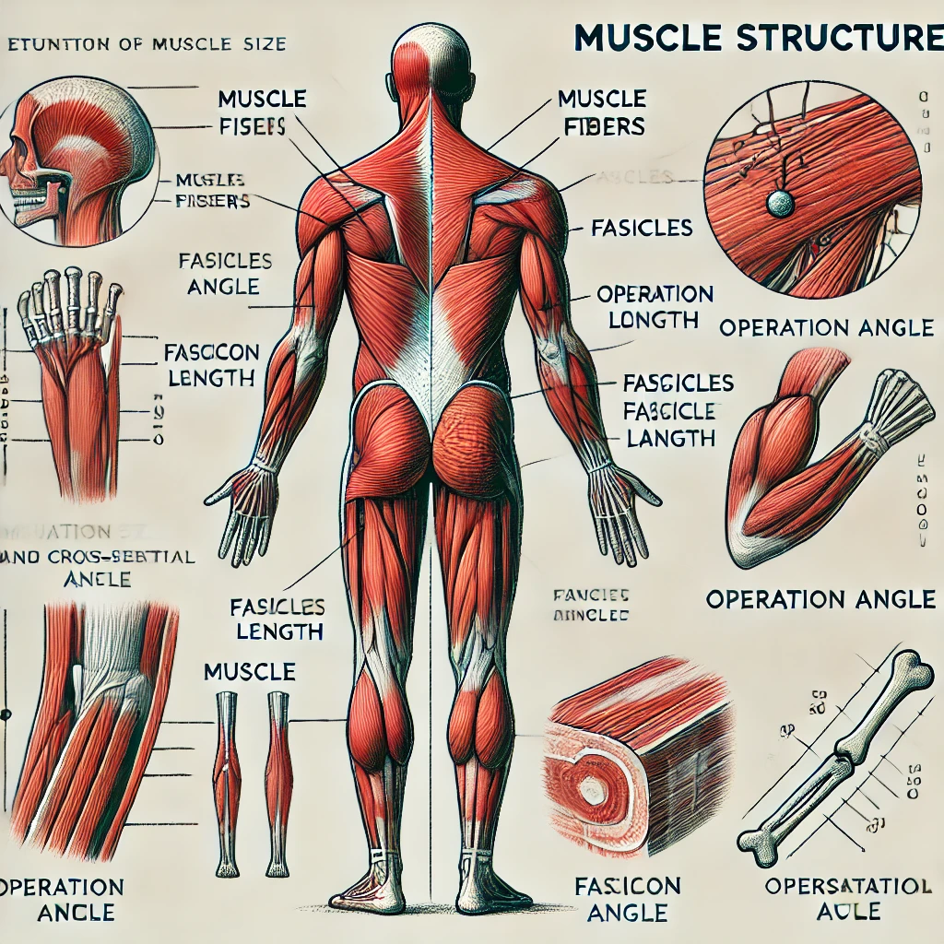
The effects of neuromuscular activity and muscle structure on stepping performance in older adults

Slide 7
Introduction

Slide 8
Balance recover
Why balance recover?
Falls
1/3 of older adults (≥ 65 yrs) fall…
Half of the falls lead to injury…
10% are serious injuries (e.g., hip fracture)…
Some individuals die…
Hospital cost – $50 billion (USA)
Hausdorff et al. 2001
Phelan et al 2018

Slide 9

What is one of the most common reactions when you lose your balance?

Slide 10
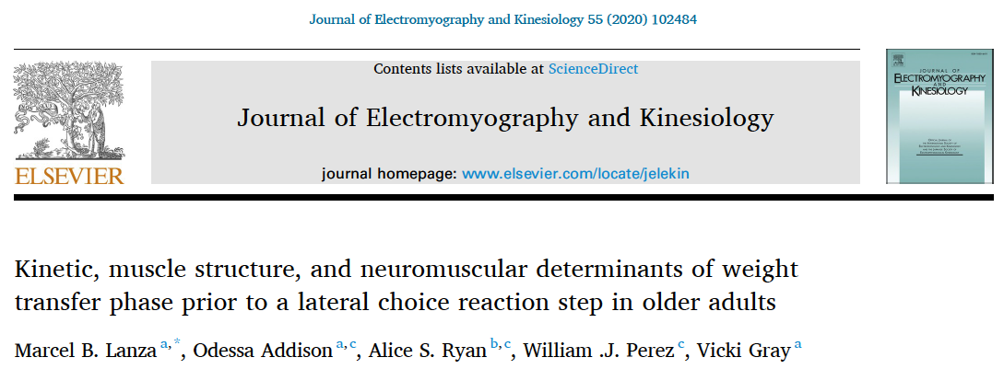
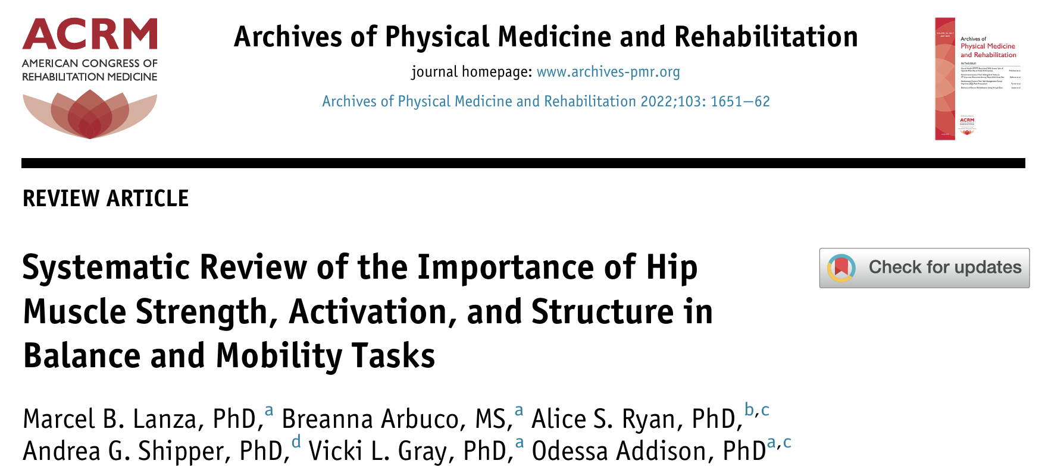

Slide 11
What about the other muscles of the inferior part of the body?

Slide 12
The effects of neuromuscular activity and muscle structure on stepping performance in older adults
Aim 1: To determine the age-associated changes of stepping performance during lateral, forward, and backward steps by comparing older and younger adults.
Aim 2: To examine the association between the muscle structure of six hip and leg muscles and the stepping performance of lateral, forward, and backward steps in older and younger adults.

Slide 13
What tasks do the participants perform during the testing sessions?
Clinical assessments
Ultrasound
Maximal contractions (with EMG sensors)
Stepping test (with EMG sensors and motion capture system)

Slide 14
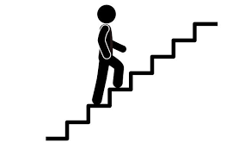
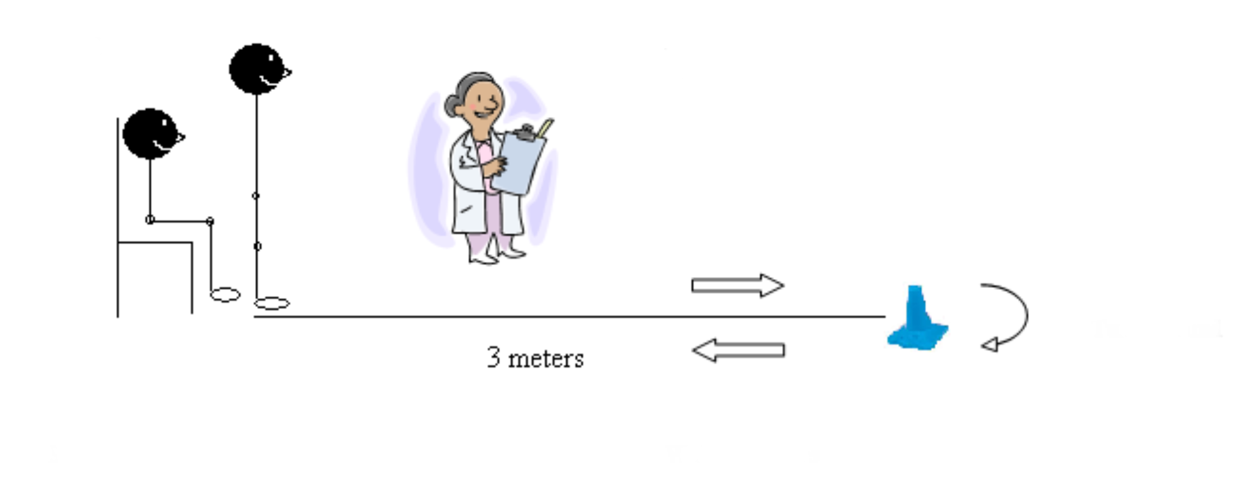
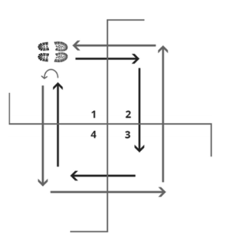
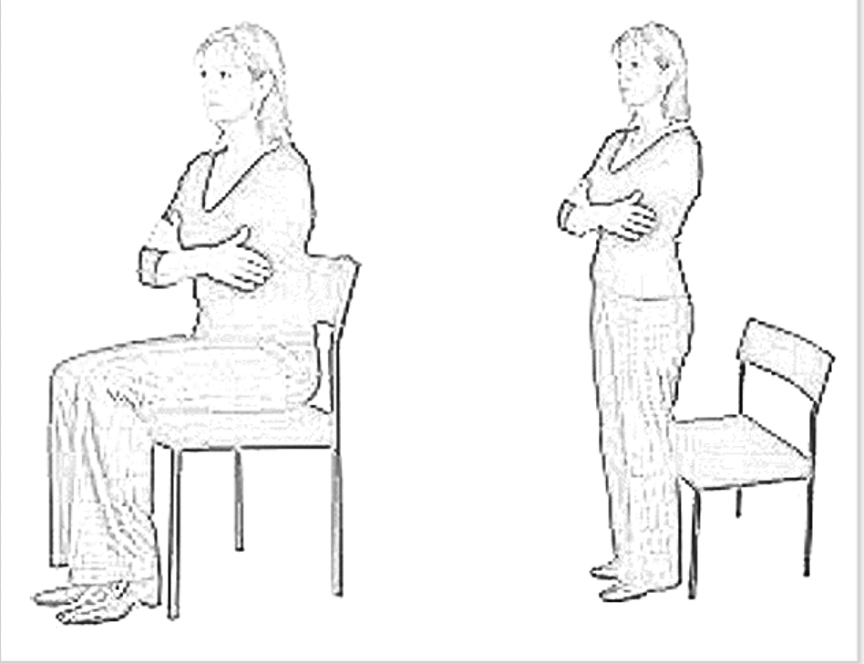
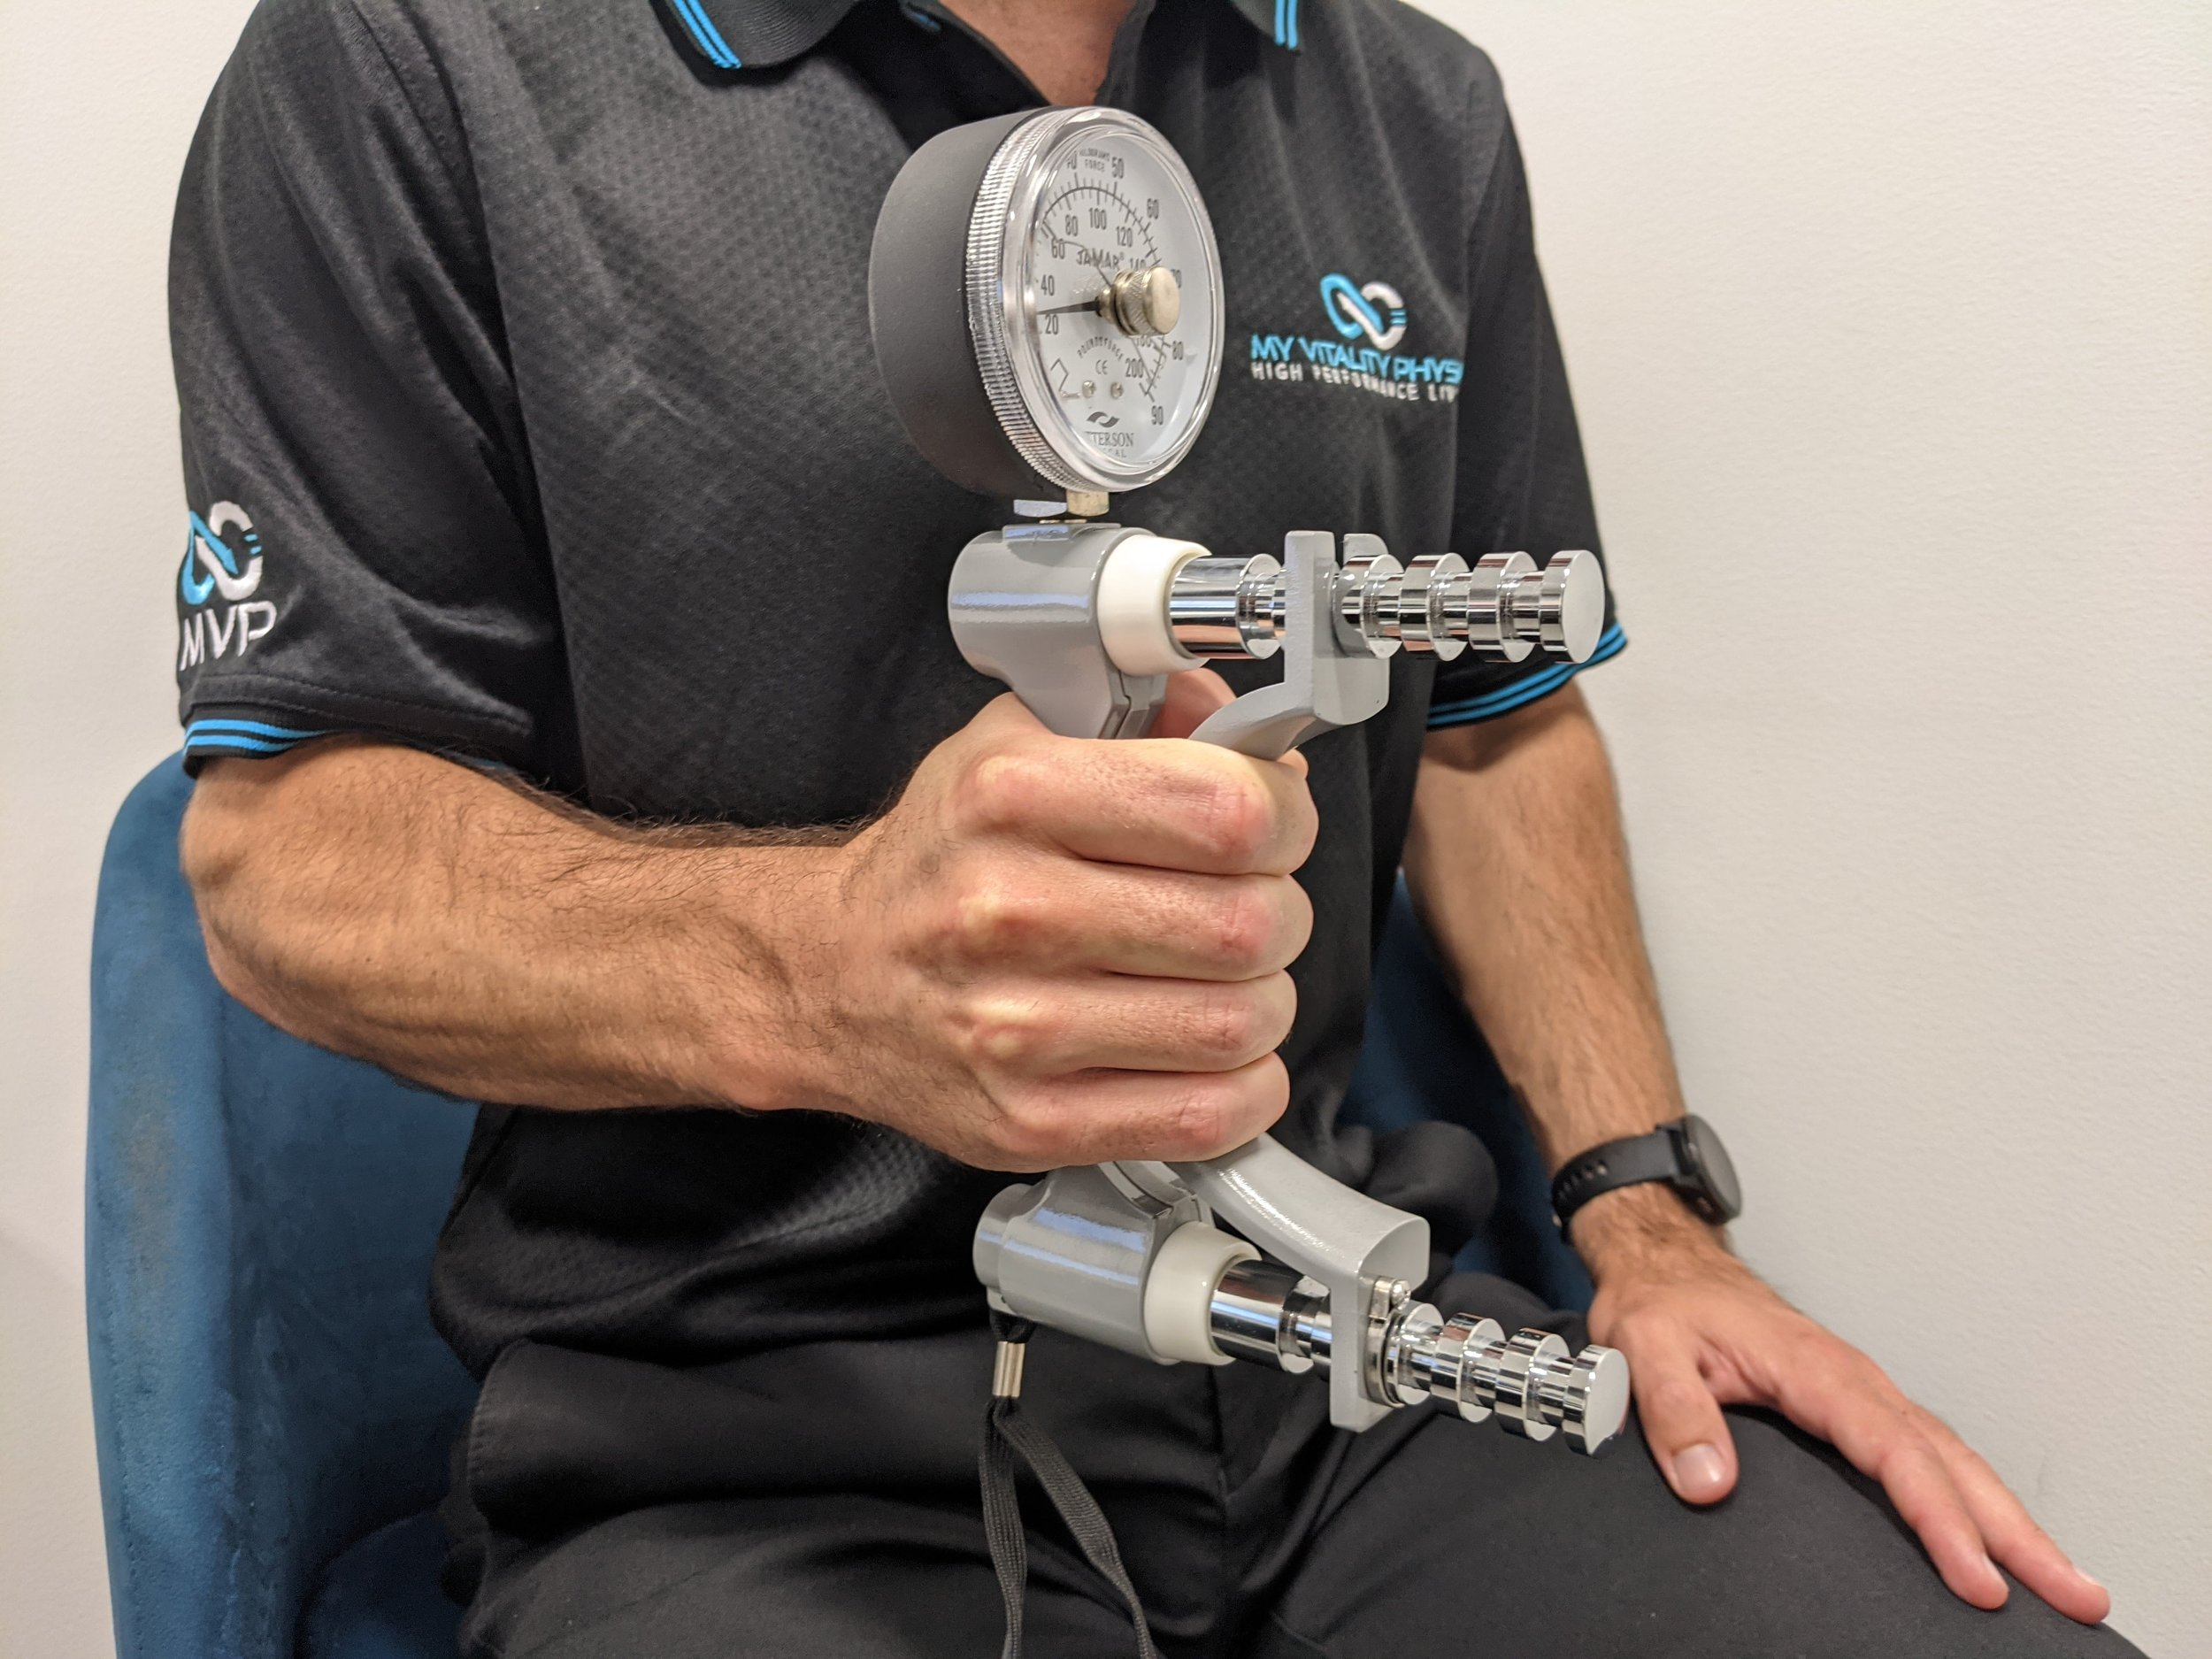
Clinical Assessments
Staircase Power Test
Time Up and Go
Four Square Step Test
Sit-to-Stand Test
Handgrip Strength Test

Slide 15
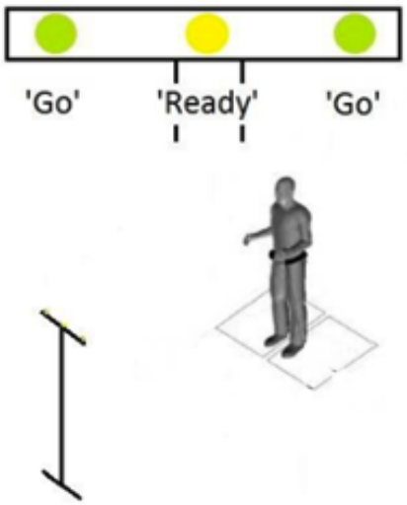
Stepping Test

Slide 16
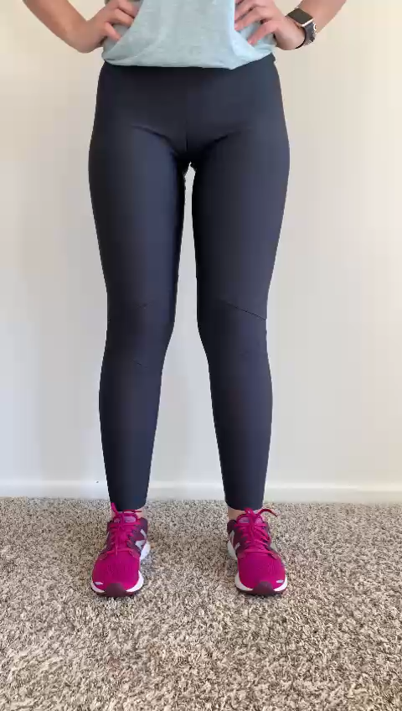
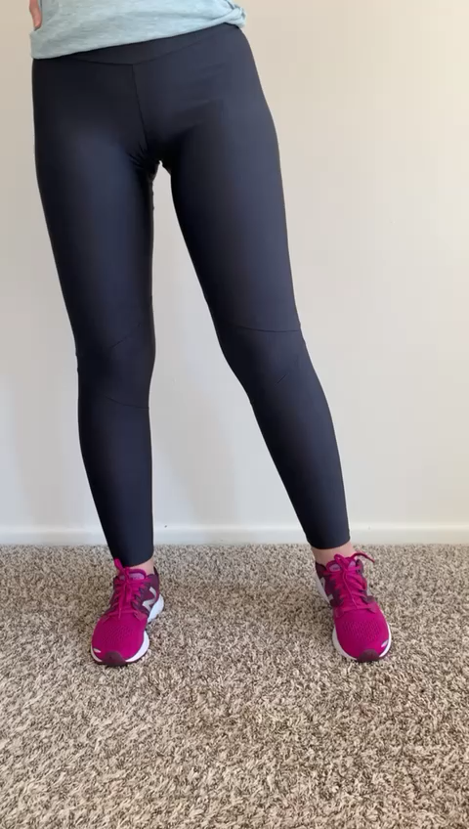
Stepping performance
Weight transfer time
Stepping time

Slide 17
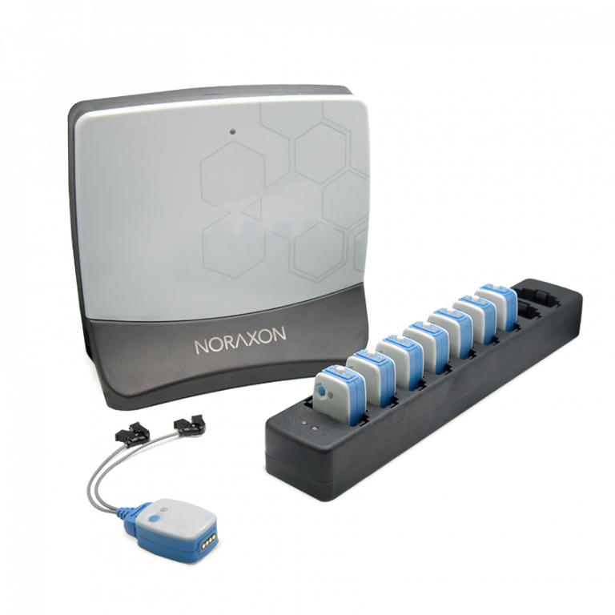
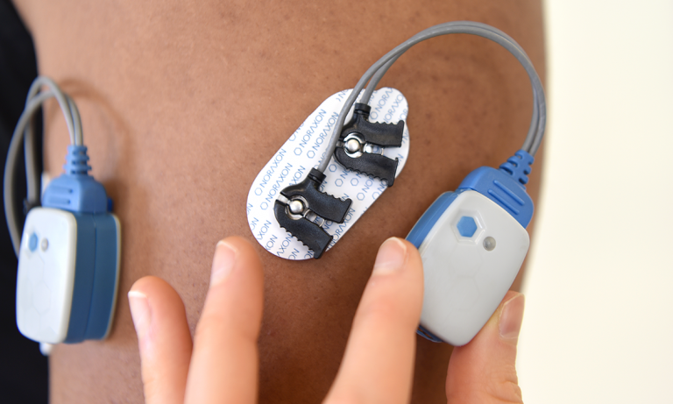
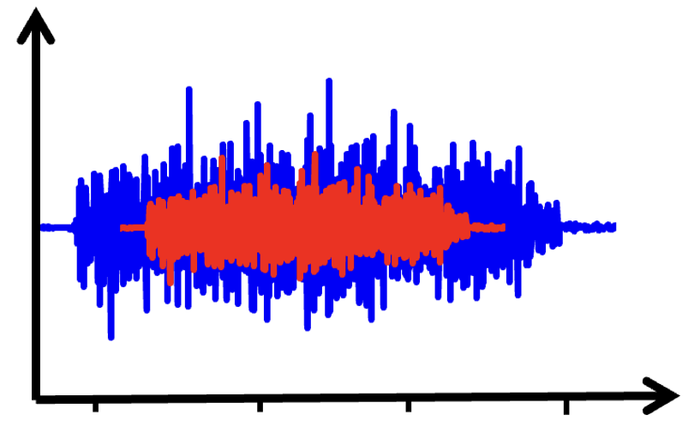
Neuromuscular activity and Muscle Morphology
Neuromuscular Activity
Amplitude of the signal from six different muscles

Slide 18
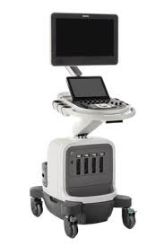
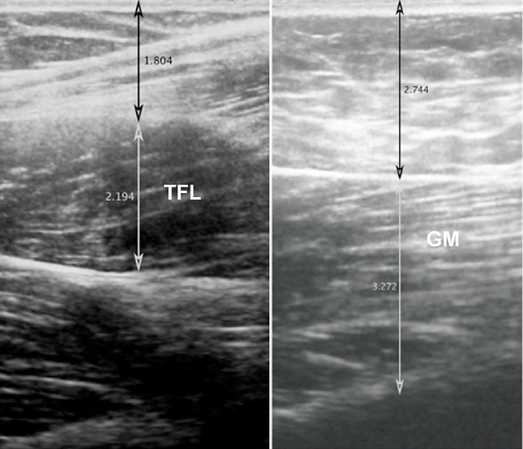
Neuromuscular activity and Muscle Morphology
Muscle Morphology
Muscle Size
Muscle Quality
Muscle Stiffness
Subcutaneous Fat

Slide 19
What I want to see from this data?
Aim 1: To determine the age-associated changes of stepping performance during lateral, forward, and backward steps by comparing older and younger adults.
Are the older adults transferring weight slower than the young adults during the lateral, forward, and backwards steps?
Are the older adults stepping slower than the young adults during the lateral, forward, and backwards steps?
Aim 2: To examine the association between the muscle structure of six hip and leg muscles and the stepping performance of lateral, forward, and backward steps in older and younger adults.
Is there an association between muscle size, muscle stifness, and intramuscular fat with the transfer of weight in young and older adults?
Is there an association between muscle size, muscle stifness, and intramuscular fat, and the stepping time in young and older adults?
Are these associations different between young and old adults?

Slide 20
Sample Size
Sample size: 21 (13 younger adults / 8 older adults)
Sample size goal: 30 (+ 2 younger adults and 7 older adults).

Slide 21
Thank You!
Questions?
mlanza@som.umaryland.edu

